Slide 1


O2 - EVERY BREATH COUNTS

Slide 2
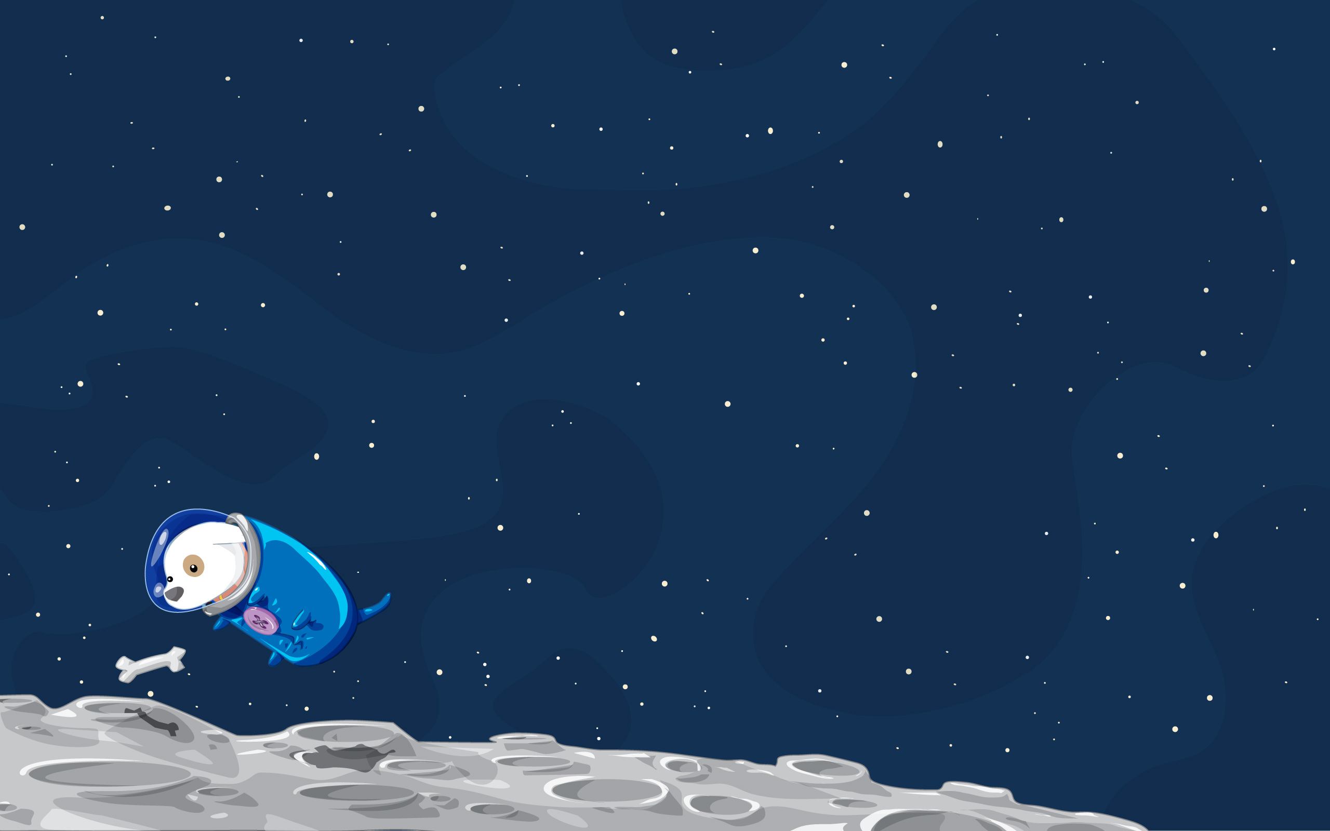
?
1. MULTIPLAYER
MINIMUM VIABLE PRODUCT
(SINGLE LEVEL)
2. MOVEMENTS
OBSTACLES
CHARACTER
Auto Run
Jump
Duck
Accelerate
Random Positions
Keep Moving
Detrimental upon impact
Win -> Survive
3. WIN/LOSE
Lose -> No O2 (Energy Bar system)

